Slide 1

TEAM DETAILS:
Team Name : Yakuza
2. Members Name and Phone Numbers :
Abinesh Balaji B (19euec004) (Leader)-7397778840
Abdul Wahhab A R (19euec002)-9361487029
Aniruth Chakravarthy N (19euec013)-8760702989
MENTOR : DR.A.Albert Raj
3. Domain name : OPEN INNOVATION.
4. Problem statement : In tourism industry Guides plays major role. But problem with the guide is
Unpredictable expenses
Accomodation in our transport
Security is one of the major challenges faced by Indian Tourism.
The increasing rate of sexual abuse of women, theft, food poisoning, terrorism, and public violence is affecting Indian Tourism to a high extent.
In order to avoid this, we propose this project.

Slide 2
ABSTRACT
GET CONTROL OF THE EXPENSES FOR GUIDE IN YOUR PRESIOUS TOUR.
AVOID ACCOMADATION IN YOUR TRANSPORT , HOTELS AND RESTAURANTS.
OVERCOME THE BUSINESS DEPLITION OF TOURIST GUIDE AS A CONSEQENCE OF PANDAMIC SITUATION(COVID-19).
A DEVICE TO GET THE BETTER OF THE ABOVE PROBLEMS BY USING RASPBERRY PI.
A TOURIST GADGET to overcome the presence of Tourist Guide.
Similar to Alexa, using voice assistant this gadget helps to lead the way for tourist by providing location, direction, weather, hotels,restaurants and particulars about that location or spot.

Slide 3

NOVELTY
Rather than being searched visually in Google, we can utilize this gadget and can gather our particulars of the spot through auditory perception identical to google assistant & Alexa, which will also be more favourable for visually impaired people.

Slide 4

Technology Stack Used
ARTIFICIAL INTELLIGENCE(AI)
IOT(Internet of Things)
MACHINE LEARNING
RASPBERRY PI
SPEAKERS
GPS
SD CARD
POWER SUPPLY UNIT
RELAY UNIT
GYROSCOPE SENSOR
HUMIDITY SENSOR

Slide 5
HARDWARE / SOFTWARE IMPLEMENTATION
Sensors like GPS, Gyroscope and humidity sensors are connected to Raspberry PI .
Raspberry PI is connected to cloud storage for online news feeds .
The guide can store information about the recent events in SD card which is connected to Raspberry PI.
Power supply and relay unit are used .

Slide 6
BLOCK DIAGRAM
HUMIDITY
SENSOR
RASPBERRY PI B+
CLOUD STORAGE
HUMIDITY
SENSOR
RASPBERRY PI B+
CLOUD STORAGE
GYROSCOPE
SENSOR
GYROSCOPE
SENSOR
EVENT MESSAGES
MOBILE
APPLICATION
EVENT MESSAGES
GPS SENSOR
MOBILE
APPLICATION
GPS SENSOR
SD CARD
SD CARD
DIRECTION
MESSAGES
DIRECTION
MESSAGES
POWER SUPPLY
POWER SUPPLY

Slide 7

Dependencies / Limitations
Even it’s a Gadget that have been carried by the tourist, information must be updated day by day manually.
Every tourists must return the gadget to sellers as they bought for rent.
This gadget cannot be used without internet.

Slide 8
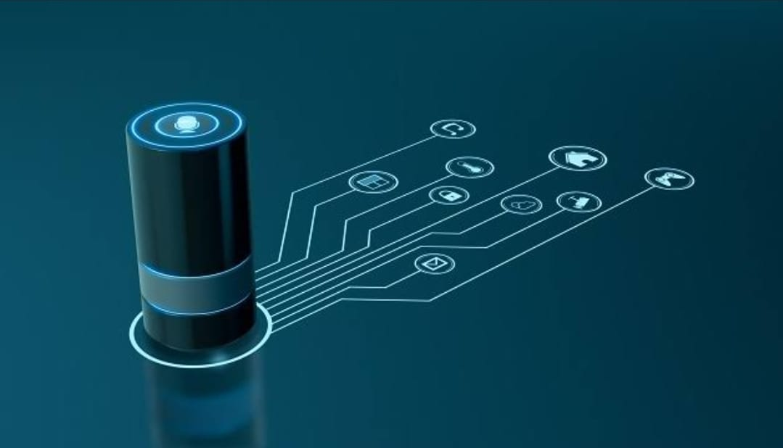
BUSINESS PROCESS:
By establishing mass production of this device -> selling to sellers and dealers -> sold by tourist guides to tourists for rent->tourists can buy it buy paying advance -> tourists must return the bought gadget to tourist guide again -> tourist will get the cash back (excluding charges for rent).
How it’s better than existing solutions
Even so the gadget isn't existing, after formulation the tourist guide can do his job trouble-free and concurrently they can cope with many tourist.
“Thus the Tourist Guides have made financial gain and developed their business using our Gadget.”

